Slide 1

Project Topic:
Collaborative Learning Through Multiple Private Datasets Ensuring Data Privacy
CS 6804: AI Technologies for Cybersecurity Defenses
Instructor:
Professor Daphne Yao
Professor
Elizabeth and James E. Turner Jr. '56 Faculty Fellow
CACI Faculty Fellow
Department of computer science, Virginia Tech
Presented by:
Tanmoy Sarkar Pias
PhD Student
Department of computer science, Virginia Tech

Slide 2
Contents
The Problem Statement
Methodology
Dataset Visualization
Implementation Steps
Results
Conclusion

Slide 3


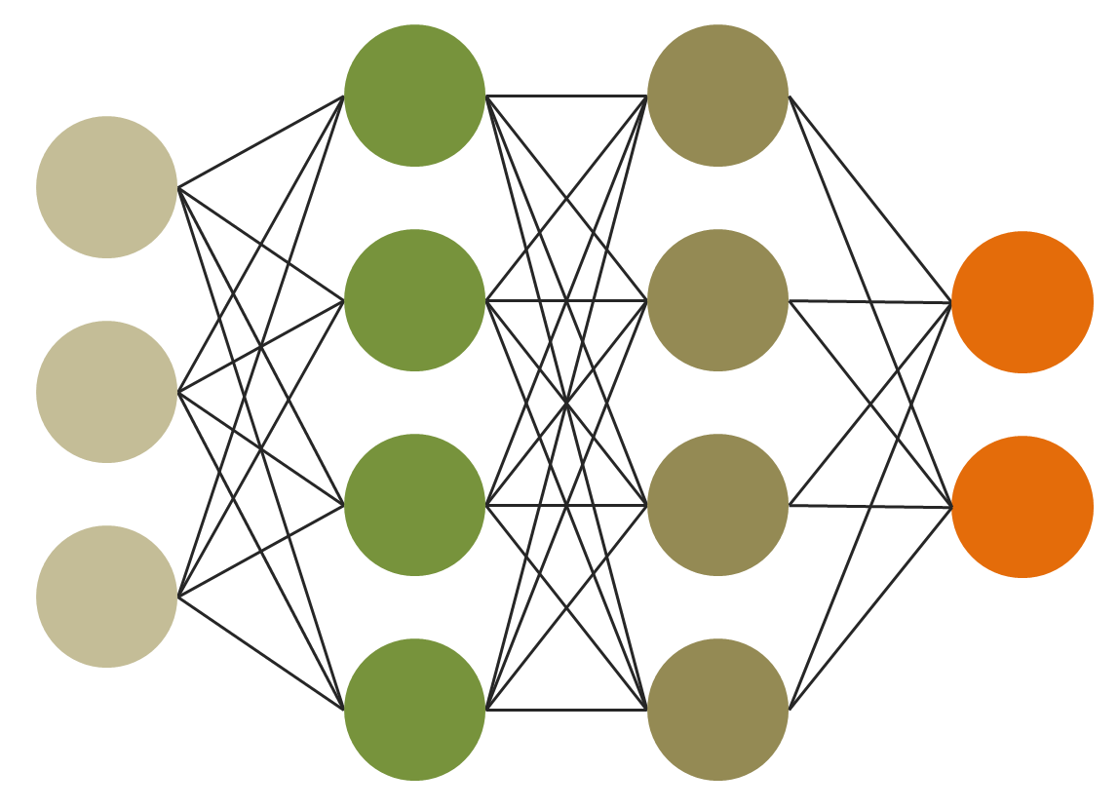

The Problem Statement
Building a collaborative prediction system, using differentially private machine learning models trained on the available datasets.
Challenges:
Training-data Extraction attacks
Membership inference attacks

Slide 4

Membership Inference Attacks

Slide 5
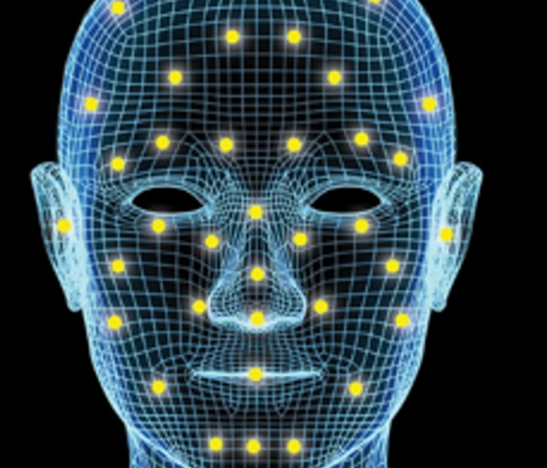
Training-data Extraction attacks

Slide 6

Goal

Slide 7




Noise
Local ML Model
Private and
sensitive data
Public ML Model
Public Dataset
Noise
Attack
Local ML Model
Adversary
Private and
sensitive data
..
.
Attack
Noise
Local ML Model
Private and
sensitive data

Slide 8
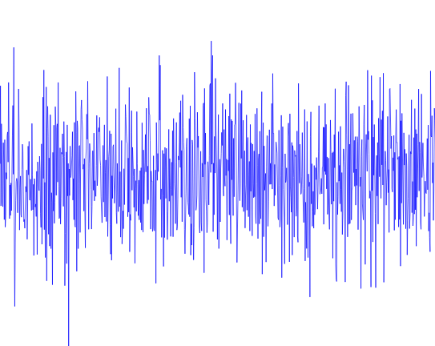
Methodology
Using differential privacy on each private (teacher) models.
Aggregate all the models predictions to label a public (unlabelled) dataset.
Train a model on the public dataset.
This is an application of Private Aggregation of Teacher Ensembles (PATE) model.

Slide 9
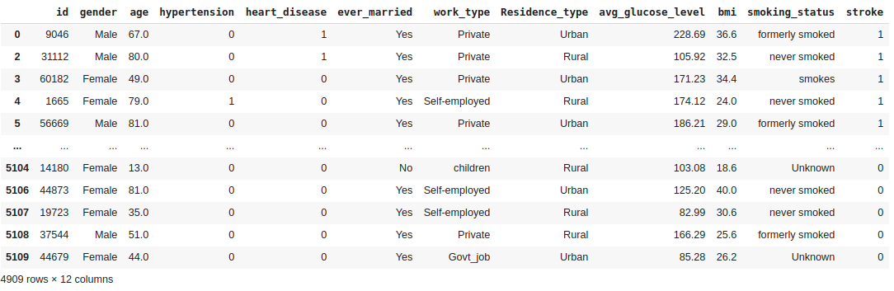
Dataset: Heart Stroke Prediction Data
Dataset source: https://www.kaggle.com/fedesoriano/stroke-prediction-dataset

Slide 10
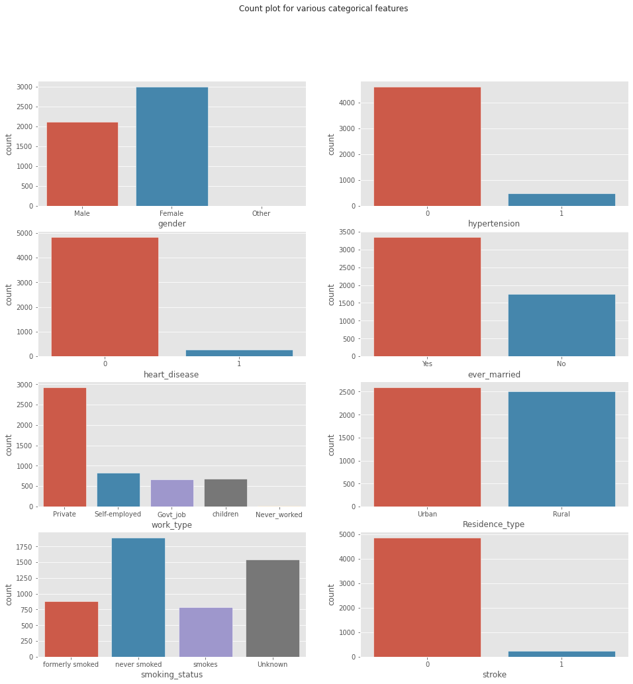
Dataset Statistics

Slide 11
Dataset Statistics

Slide 12
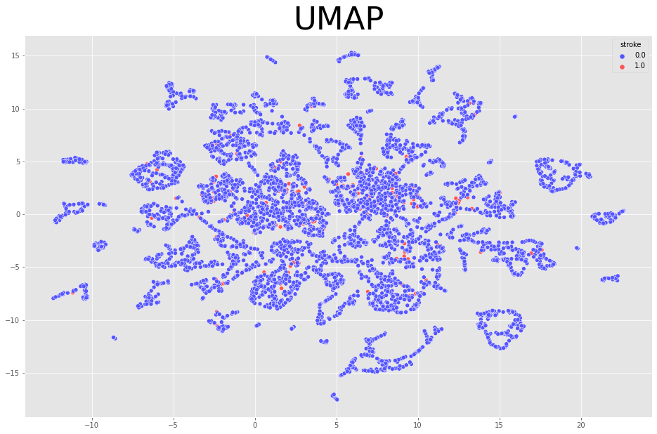
Dataset Statistics

Slide 13
Steps:
Dataset categorical features are converted to 1-hot encoding.
Dataset is splitted into 2 subsets. One for teachers (70%) and the other for student (30%) model.
Dataset is divided into equal n-segments.
n-teacher model is trained separately on those data-segments. 4-layer Neural Network model is used as teacher model.
Student’s data subset is splitted again into two subsets. Train set (70%) and test set (30%).
Each teacher predicts the labels of Student-Train-set. So, each data-points has n-labels.
Noise is added to the labels of Student-Train-set. (Differential Privacy!!)
One label is selected based on the majority.
The labeled-Student-Train-set is used to train the Student-model.

Slide 14
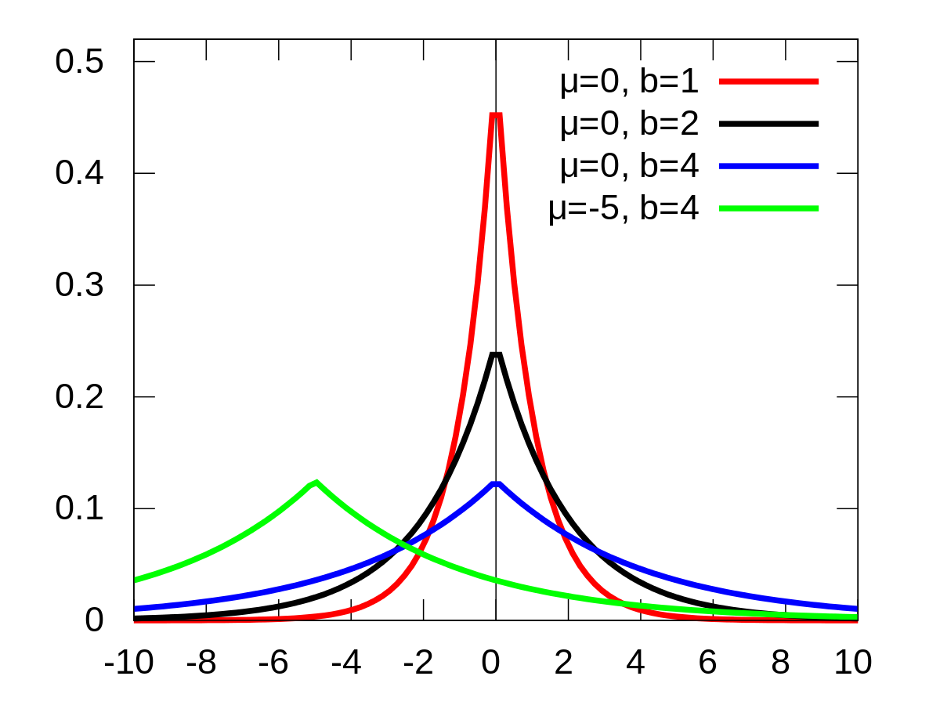
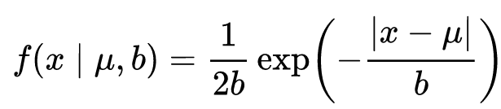
Differential Privacy with Laplacian Noise
For many problems in economics and health sciences, this distribution seems to model the data better than the standard Gaussian distribution.
Ref: https://numpy.org/doc/stable/reference/random/generated/numpy.random.laplace.html

Slide 15
Results
# of Teacher Models | Teacher Accuracy (Max) | epsilon = 1/b (privacy budget) | # of Wrong Labels / Total Data-points (after adding noise) | Student Accuracy
5 | 0.984 | 0.005 | 58/295 | 0.797
5 | 0.984 | 0.05 | 55/295 | 0.815
5 | 0.984 | 0.5 | 17/295 | 0.937
5 | 0.984 | 5 | 0/295 | 1.00

Slide 16
Results
# of Teachers | Teacher Acc (Max) | Epsilon (privacy budget) = 1/b | # of wrong labels (after adding noise) | Student Accuracy
2 | 0.984 | 0.5 | 62/295 | 0.794
3 | 0.984 | 0.5 | 43/295 | 0.856
4 | 0.984 | 0.5 | 21/295 | 0.922
5 | 0.984 | 0.5 | 17/295 | 0.937
6 | 0.984 | 0.5 | 16/295 | 0.946
7 | 0.984 | 0.5 | 19/295 | 0.939
8 | 0.984 | 0.5 | 15/295 | 0.951
10 | 0.984 | 0.5 | 10/295 | 0.969
20 | 0.984 | 0.5 | 2/295 | 0.992

Slide 17
# of Teacher Models | Teacher Accuracy (Max) | Epsilon = 1/b (privacy budget) | # of Wrong Labels / Total Data-points (after adding noise) | Student Accuracy
2 | 0.984 | 0.5 | 62/295 | 0.794
3 | 0.984 | 0.5 | 43/295 | 0.856
4 | 0.984 | 0.5 | 21/295 | 0.922
5 | 0.984 | 0.5 | 17/295 | 0.937
6 | 0.984 | 0.5 | 16/295 | 0.946
7 | 0.984 | 0.5 | 19/295 | 0.939
8 | 0.984 | 0.5 | 15/295 | 0.951
10 | 0.984 | 0.5 | 10/295 | 0.969
20 | 0.984 | 0.5 | 2/295 | 0.992

Slide 18
Conclusion
Privacy is inversely related to model accuracy.
If we want to increase model accuracy as well as the privacy, we have to increase the number of teacher models.

Slide 19
Thank you!
Any Questions?

